Slide 1
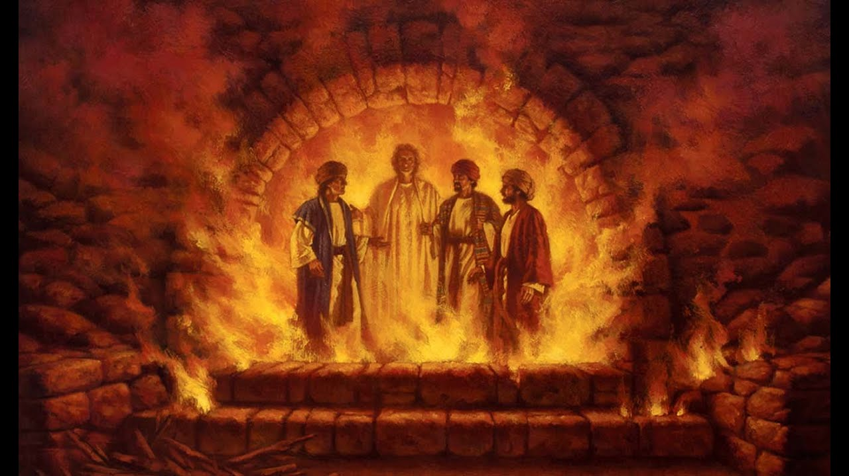
DANIEL
Righteous Hero of Faith

Slide 2


Slide 3
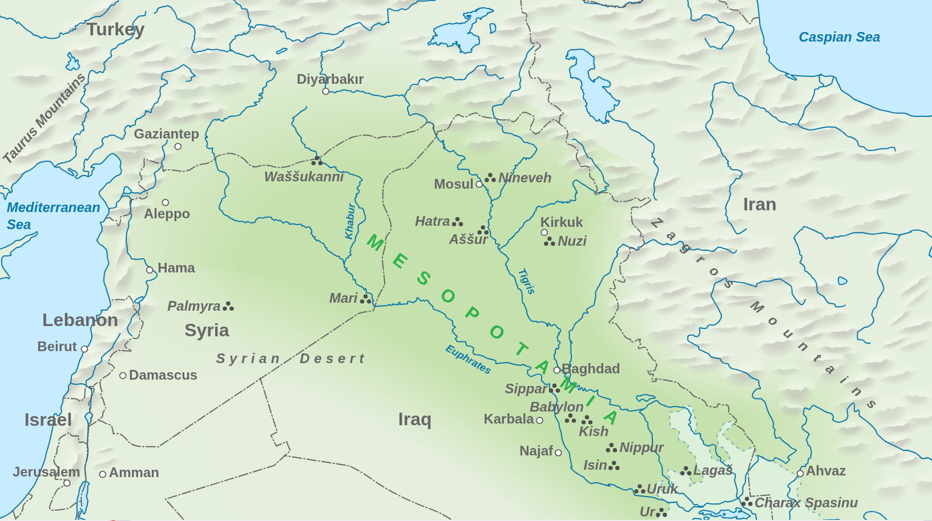

Slide 4
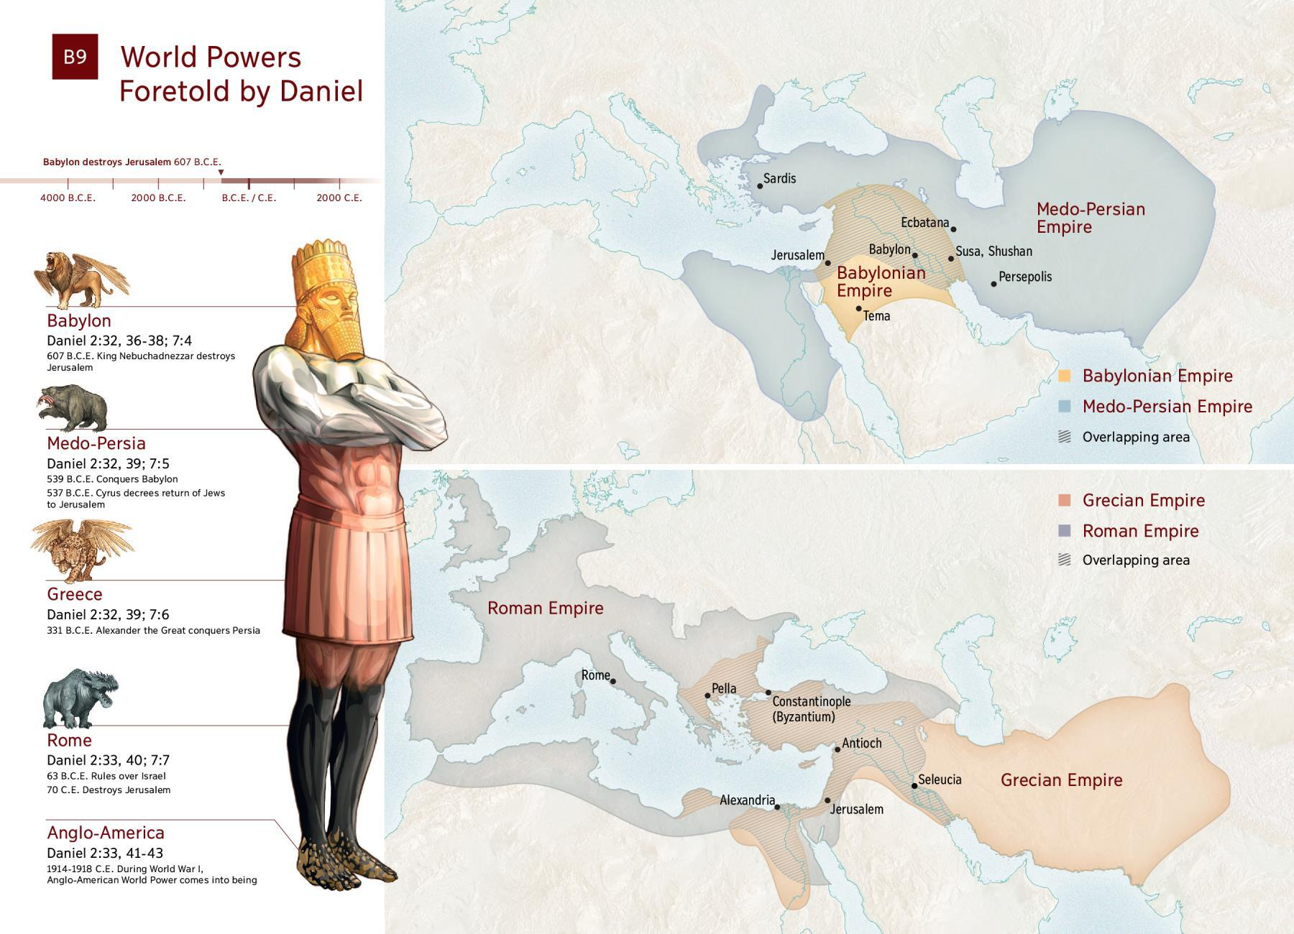

Slide 5
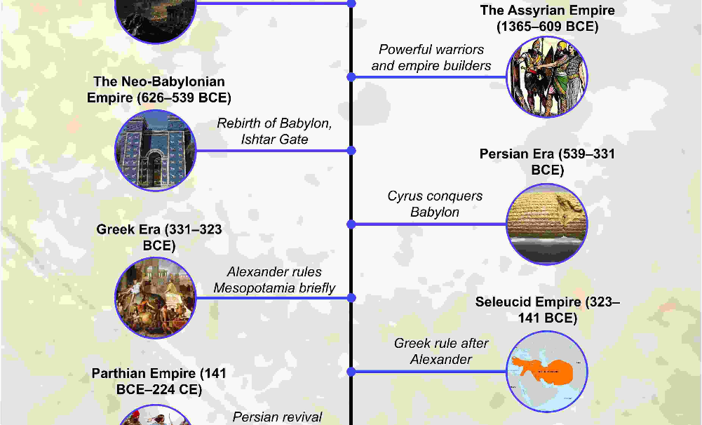

Slide 6
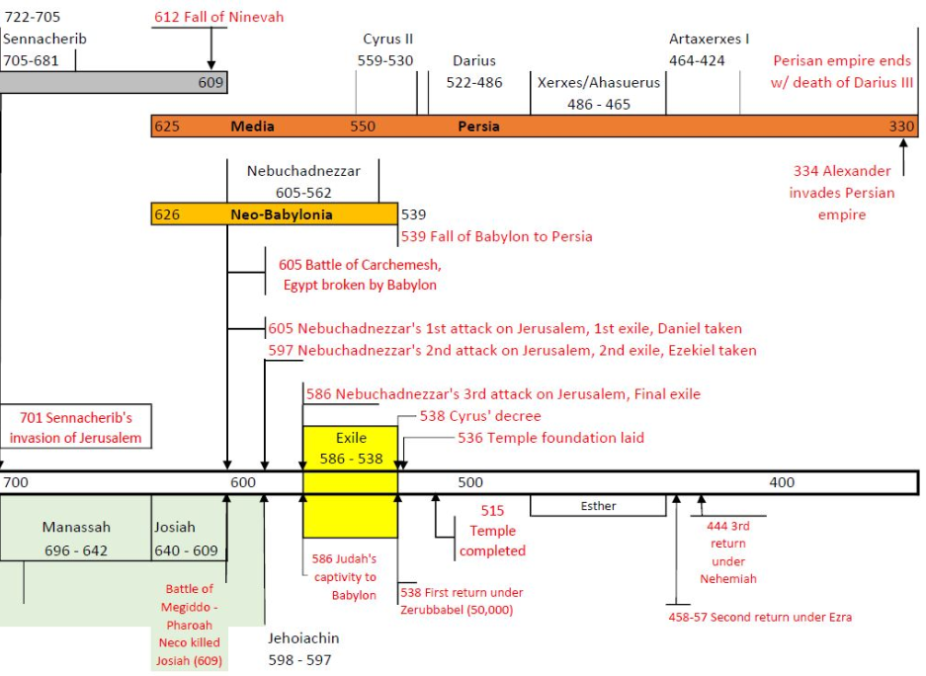
Notes:
The Fall of Nineveh (World’s Greatest City) in 612 BC was a historic battle where a coalition of Babylonians, Medes, and Scythians besieged and sacked the capital of the Neo-Assyrian Empire, ending Assyrian dominance and shifting power to Babylon.
Nineveh fell to the allied Babylonian and Median forces in 612 BC, an event that cleared the way for the Neo-Babylonian Empire to rise to power. Daniel was subsequently taken captive to Babylon just a few years later in 605 BC under King Nebuchadnezzar.

Slide 7
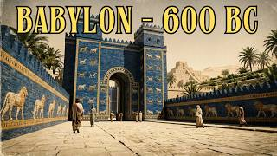

Slide 8
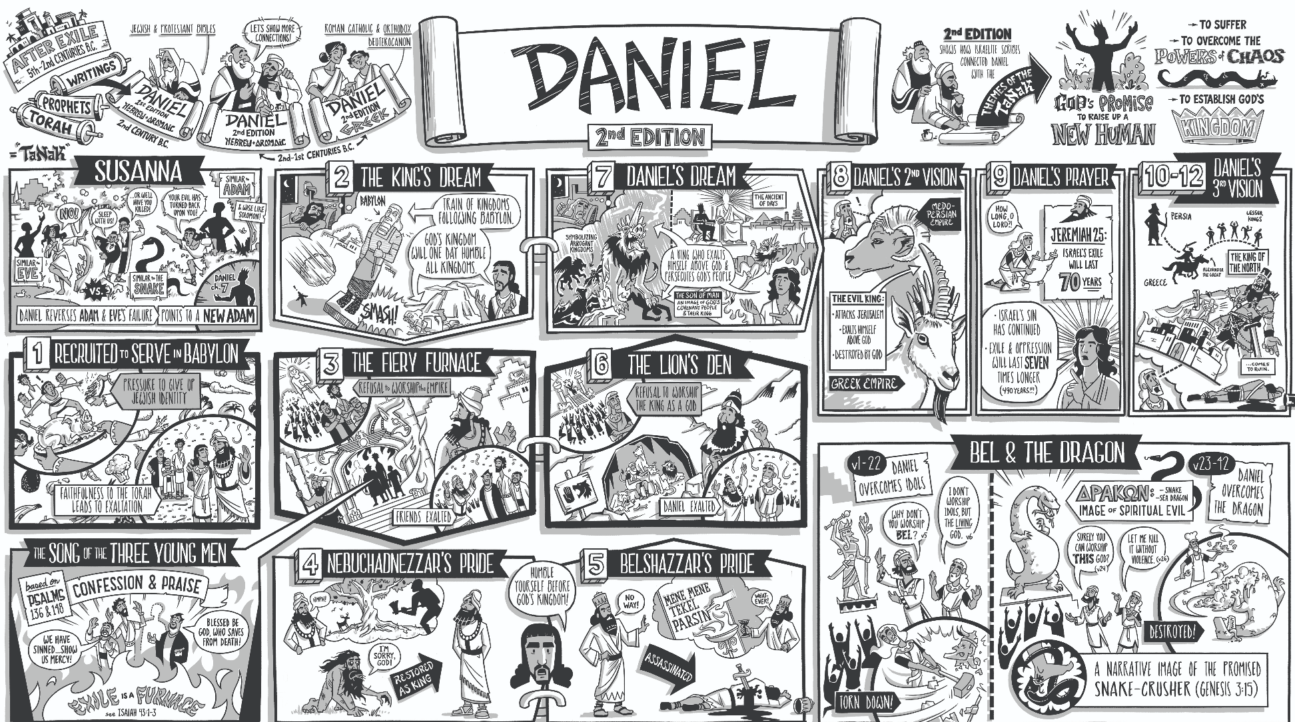

Slide 9
CHIASMUS
A Greek word that describes a literary structure
Derived from Greek letter chi which looks like an X
Whichever way you cut the ‘X’ in half you will see it is reflected
This can be described as units or blocks of ideas:
A
B
C
C
B
A
The most important message is at the centre: ‘X’ marks the spot.

Slide 10
