Slide 1
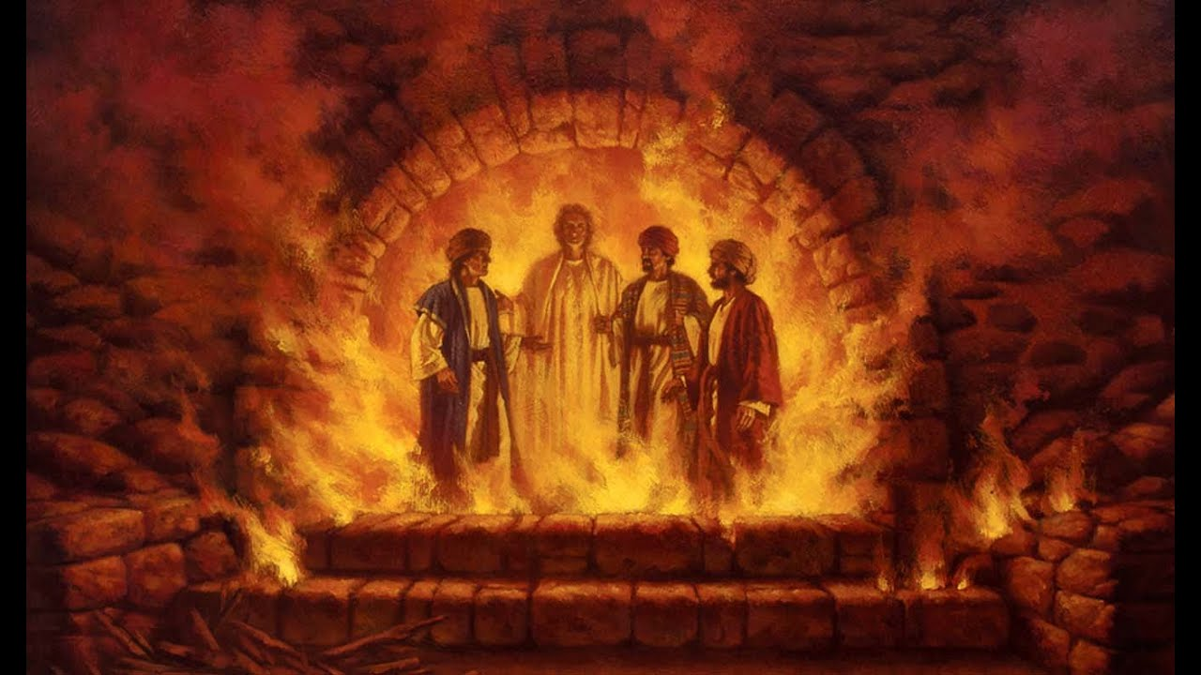
DANIEL
Righteous Hero of Faith

Slide 2
PRAYER
Creator God, we are all made in your image and are called to be like you through your Son. Too often we have tried to create others in our own image - colonizing identity through language, customs, and diet. Help us find you in everyone we meet, and give us grace to change where it conforms us to you.
Amen.

Slide 3
CHAPTER ONE
Context – The Golden Age of Babylon
During the third year of King Jehoiakim’s reign in Judah, King Nebuchadnezzar of Babylon came to Jerusalem and besieged it.
Theme
Nevertheless, “God is still God.”

Slide 4
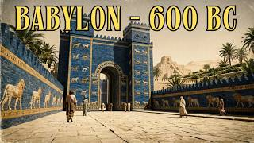

Slide 5
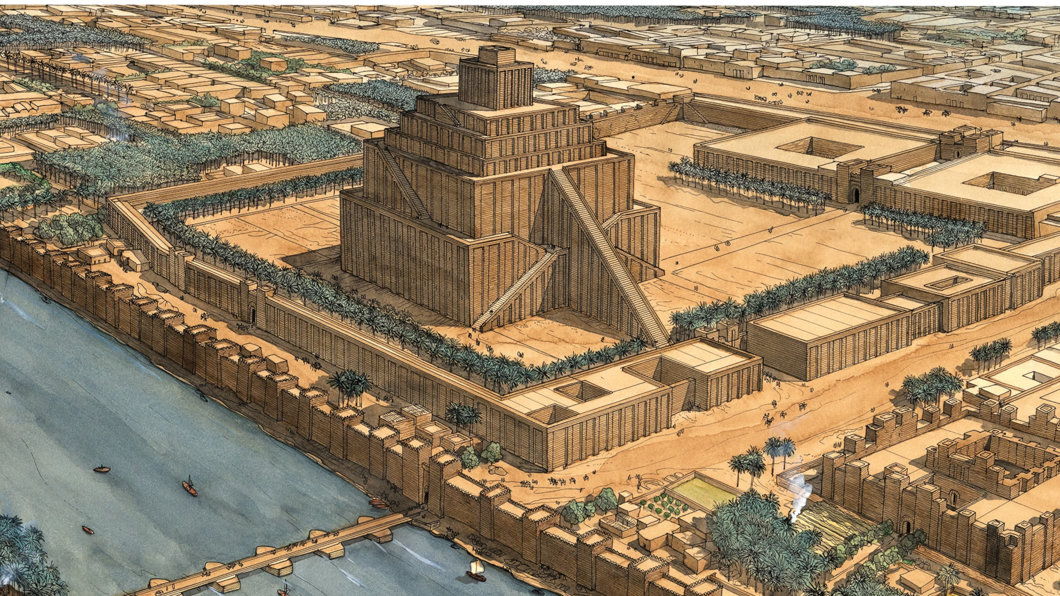
ZIGGURAT
Etemenanki
Notes:
So Nebuchadnezzar took them back to the land of Babylonia^{[b]} in Hebrew the land of Shinar. The location of the Tower of Babel and therefore a symbol of opposition to God (Gen 11) and “the place where wickedness is at home” (Zech5.11).

Slide 6
Notes:
How would you describe Daniel?

Slide 7
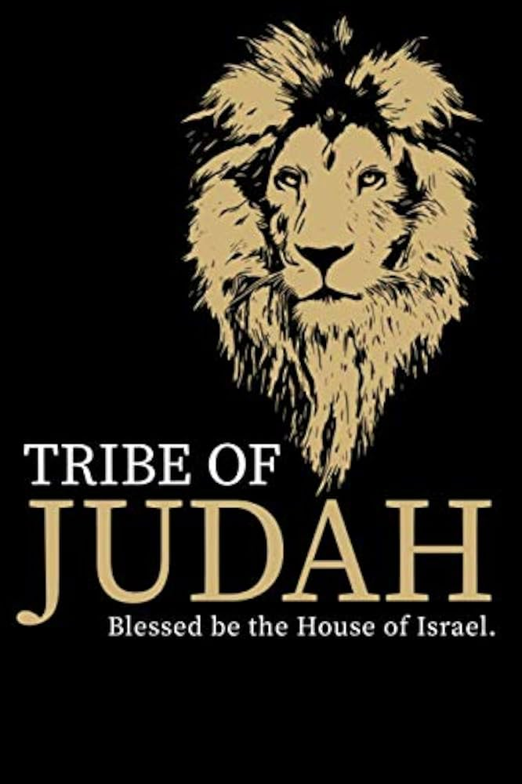
JUDAH
One of Jacob’s (Israel’s) sons
Therefore, one of the 12 tribes of Israel
Royal Leadership: “the scepter will not depart from Judah” (Gen49.8-10)
Davidic Dynasty (David & Solomon)
Messianic lineage (Jesus)
Jerusalem (ancestral territory)
Source of identifier “Jew”
Source of Messianic title “the Lion of Judah” (Rev 5) → Aslan
Name means “praise”

Slide 8
RESISTANCE
& IDENTITY
How is Daniel’s identity at risk?
How does he resist colonisation?
Have you seen or experienced anything similar?
Notes:
Dietary laws (purity laws not really at risk - no impediment to drinking wine)
What does the test demonstrate?
Relationship with chief of staff - God had given him respect and affection – Negotiation?
Renaming
Education

Slide 9
RESISTANCE
& IDENTITY
How is Daniel’s identity at risk?
How does he resist colonisation?
Have you seen or experienced anything similar?
Notes:
Dietary laws (purity laws not really at risk - no impediment to drinking wine)
What does the test demonstrate?
Relationship with chief of staff - God had given him respect and affection – Negotiation?
Renaming
Education

Slide 10
WHAT’S IN A NAME?
Daniel – “God is my judge” (or “Judge of God”).
Hananiah – “Yahweh is gracious” /
“the Lord has been gracious to me.”
Mishael – “Who is like God?” (a rhetorical question affirming God’s uniqueness).
Azariah – “Yahweh has helped” / “the Lord
is my help.”
Notes:
Dietary laws (purity laws not really at risk - no impediment to drinking wine)
Relationship with chief of staff - God had given him respect and affection – Negotiation?
Renaming
Education

Slide 11
WHAT’S IN A NAME?
Belteshazzar “Bel, protect the king” or “Bel’s prince” (Marduk/Bel)
Shadrach “Command of Aku” or “under the command of Aku” (Aku - Moon)
Meshach “Sheik/Shesach” (Babylonian Goddess) / “guest of a king” or “that draws with force.”
Abednego “Servant of Nebo/Nabu”
Notes:
Dietary laws (purity laws not really at risk - no impediment to drinking wine)
Relationship with chief of staff - God had given him respect and affection – Negotiation?
Renaming
Education

Slide 12
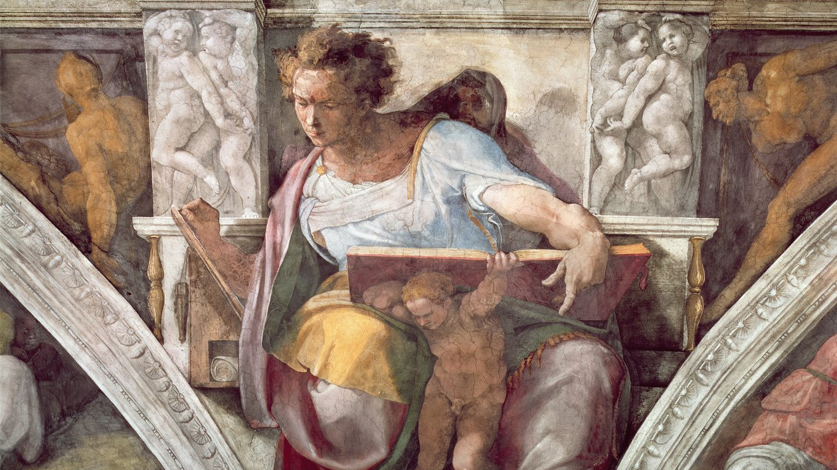
Notes:
What do you know about Daniel now?
Can you think of any parallels in your own life or others?

Slide 13
BIBLICAL LINKS+
Joseph (Gen 41)
Ezra and Nehemiah (Ezra & Nehemiah)
Mordecai and Esther (Esther)
Can you make links to any more contemporary figures?

