Slide 1
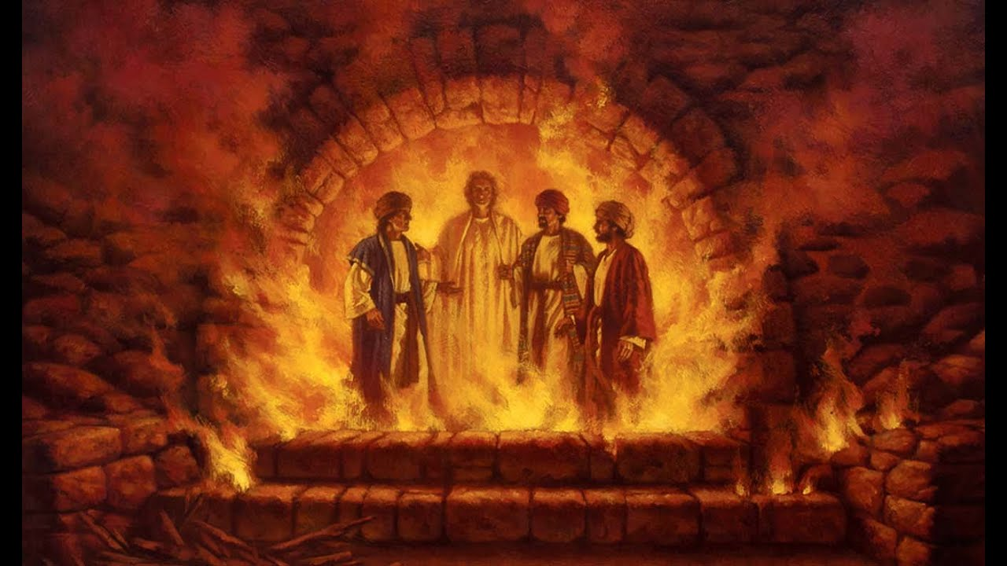
DANIEL
Righteous Hero of Faith
THE DREAM

Slide 2
PRAYER
“Praise the name of God forever and ever,
for he has all wisdom and power.
He controls the course of world events;
he removes kings and sets up other kings.
He gives wisdom to the wise
and knowledge to the scholars.
He reveals deep and mysterious things
and knows what lies hidden in darkness,
though he is surrounded by light.
I thank and praise you, God of my ancestors,
for you have given me wisdom and strength.
You have told me what we asked of you
and revealed to us what the king demanded.” (Daniel 2.20-23)

Slide 3
CHAPTER TWO
The Dream of Nebuchadnezzar
“One night during the second year of his reign, Nebuchadnezzar had such disturbing dreams that he couldn’t sleep.” (v 1)
Theme
“Truly, your God is the greatest of gods, the Lord over kings, a revealer of mysteries” (v 47)

Slide 4
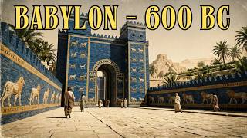

Slide 5


Slide 6
APOCALYPSE
Unveiling Reality: It lifts the veil between the earthly realm and the spiritual world, showing that history and current suffering are controlled by God.
Divine Perspective: It reframes human crises through a heavenly lens, assuring the faithful that good will ultimately conquer evil.
Eschatology: It emphasizes the final judgment, the resurrection of the dead, and the ultimate salvation or vindication of God’s people.

Slide 7
PROTO-APOCALYPTIC
Strictly speaking, this is proto-apocalyptic because it is the architectural blueprint (precursor) for chapters 2-7.
The overarching genre in chapters 2-6 is courtly narrative (a bit like Arthurian literature).
Notes:
Dietary laws (purity laws not really at risk - no impediment to drinking wine)
What does the test demonstrate?
Relationship with chief of staff - God had given him respect and affection – Negotiation?
Renaming
Education

Slide 8
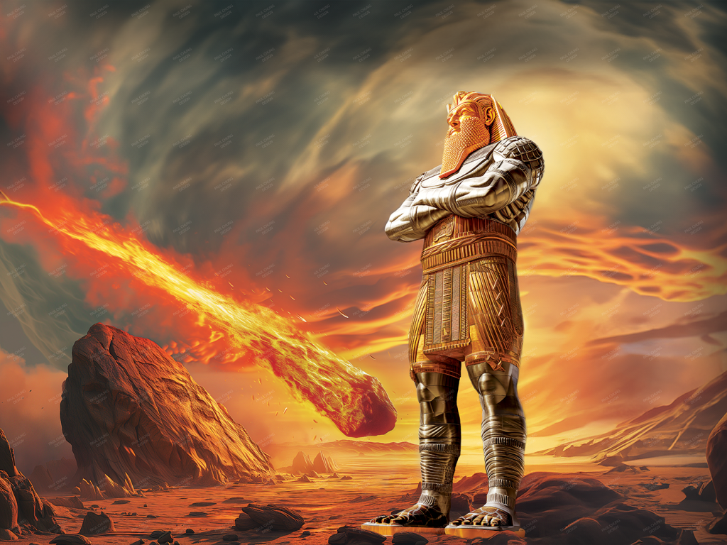
VERSES 1-16

Slide 9
WAIT A MINUTE …?
What year is this?
When did Daniel meet the King?
You want us to interpret a dream, but you won’t even tell us what it was? (v 7)
Notes:
the third year: This year would be 606, but Nebuchadnezzar became king only in 605, and his first siege of Jerusalem was in 597, shortly after Jehoiakim’s death (cf. 2 Kgs 24:8-12). The author of Dn, who perhaps combined 2 Kgs 24:1 (Jehoiakim’s three-year vassalage to Nebuchadnezzar) with 2 Chr 36:5-7 (Jehoiakim’s imprisonment in Babylon), was not concerned with such historical details that meant nothing for his spiritual message; thus, this inaccuracy is not contrary to the inerrancy of inspired Scripture.
Brown, R. E., Fitzmyer, J. A., & Murphy, R. E. 1996, c1968. The Jerome Biblical commentary. Prentice-Hall: Englewood Cliffs, N.J.

Slide 10
DRAMATIC IRONY
The astrologers replied to the king, “No one on earth can tell the king his dream! And no king, however great and powerful, has ever asked such a thing of any magician, enchanter, or astrologer! The king’s demand is impossible. No one except the gods can tell you your dream, and they do not live here among people.”
What’s going on here?
Notes:
Dietary laws (purity laws not really at risk - no impediment to drinking wine)
What does the test demonstrate?
Relationship with chief of staff - God had given him respect and affection – Negotiation?
Renaming
Education

Slide 11
DANIEL
How does Daniel respond to the order of execution?
When Arioch, the commander of the king’s guard, came to kill them, Daniel handled the situation with wisdom and discretion. He asked Arioch, “Why has the king issued such a harsh decree?” So Arioch told him all that had happened. Daniel went at once to see the king and requested more time to tell the king what the dream meant.
Notes:
Dietary laws (purity laws not really at risk - no impediment to drinking wine)
What does the test demonstrate?
Relationship with chief of staff - God had given him respect and affection – Negotiation?
Renaming
Education

Slide 12
VERSES 17-23

Slide 13
IN A CRISIS …
Tell your friends
Ask them to pray
Make the prayer specific
Prepare for a vision
Praise God
Notes:
Dietary laws (purity laws not really at risk - no impediment to drinking wine)
Relationship with chief of staff - God had given him respect and affection – Negotiation?
Renaming
Education

Slide 14
WHO IS GOD?
All wisdom and power
Controls the course of world events
Removes kings and sets up other kings
Gives wisdom to the wise and knowledge to the scholars
Reveals deep and mysterious things
and knows what lies hidden in darkness,
though he is surrounded by light

Slide 15
VERSES 24-44

Slide 16
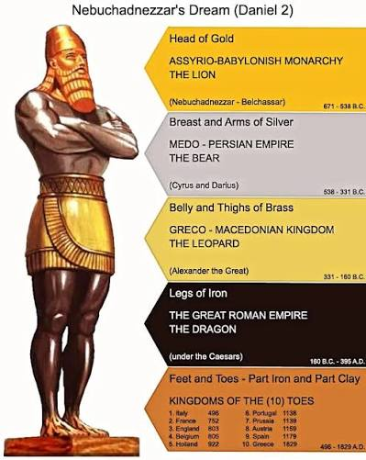
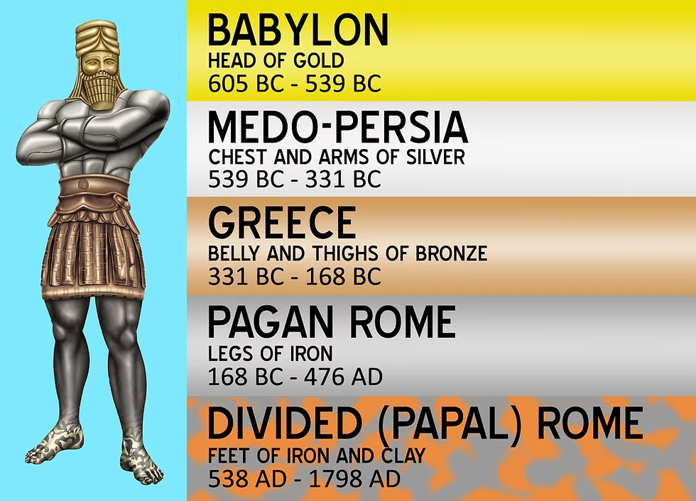
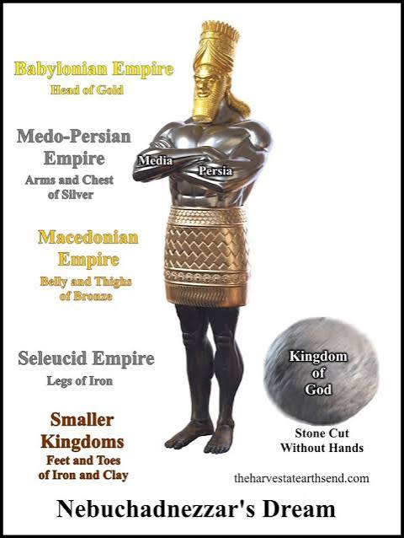
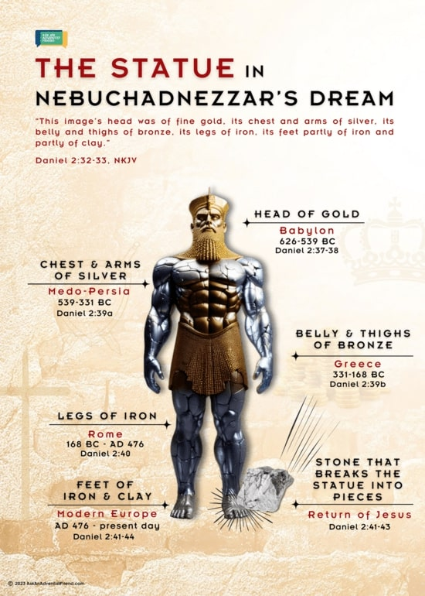
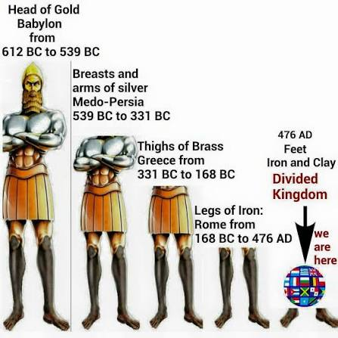
?

Slide 17
FEET OF CLAY?
“In Dan 2, the second regime is inferior to the first, the third equal to it in power, the fourth of devastating might but ultimate vulnerability.”¹
So:
Might be successive Babylonian rulers?
Might be successive Empires?
Might be perpetually relevant and tailored to each historical context? (e.g. Jews under Greek rule)?
Notes:
¹Goldingay, J. E. 2002. Vol. 30: Word Biblical Commentary : Daniel. Word Biblical Commentary . Word, Incorporated: Dallas

Slide 18
VERSES 46-49

Slide 19
JUST DESERTS?
Who gets what?
  Nebuchadnezzar
  Daniel
  God
  Shadrach, Meshach, and Abednego
Notes:
¹Goldingay, J. E. 2002. Vol. 30: Word Biblical Commentary : Daniel. Word Biblical Commentary . Word, Incorporated: Dallas

Slide 20
FINAL THOUGHT
“The sovereignty of God has been concealed from Nebuchadnezzar, relied on by Daniel, revealed via Daniel, and recognized by Nebuchadnezzar.”
Goldingay, J. E. 2002. Vol. 30: Word Biblical Commentary : Daniel. Word Biblical Commentary . Word, Incorporated: Dallas
Notes:
¹Goldingay, J. E. 2002. Vol. 30: Word Biblical Commentary : Daniel. Word Biblical Commentary . Word, Incorporated: Dallas

