Slide 1
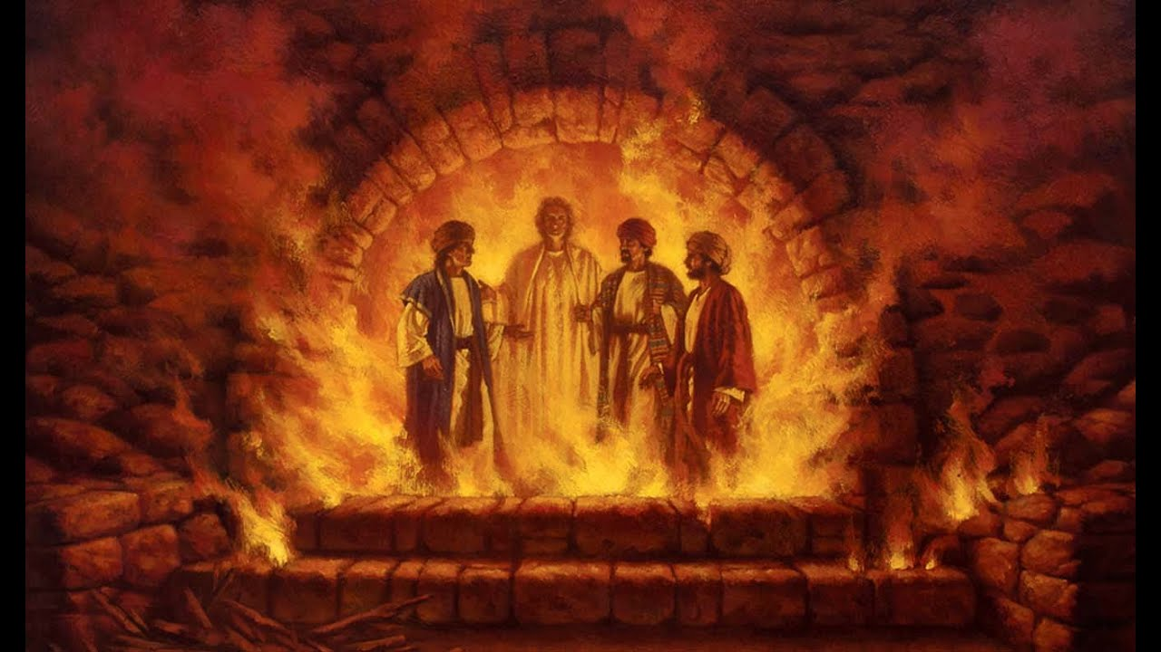
DANIEL
Righteous Hero of Faith
THE FURNACE

Slide 2
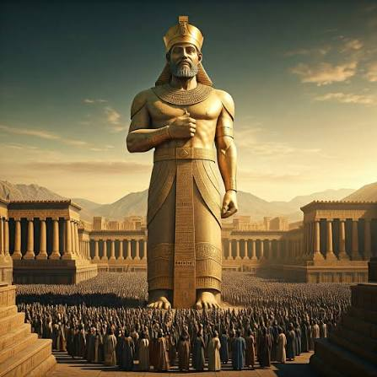
PRAYER
“Praise to the God of Shadrach, Meshach, and Abednego!
He sent his angel to rescue his servants who trusted in him.
They defied the king’s command and were willing to die rather than serve or worship any god except their own God.” (Daniel 2.20-23)
Almighty God,
Give us the same courage to trust you
In the challenges of our lives.
Send your angels in our time of need,
And preserve us.
Amen.

Slide 3
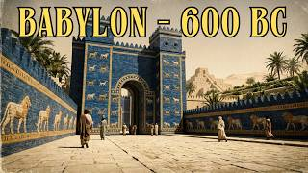
Notes:
8.05

Slide 4
CHAPTER THREE
The Statue & the Furnace
“King Nebuchadnezzar made a gold statue ninety feet tall and nine feet wide” (v 1)
Theme
“[W]e want to make it clear to you, Your Majesty, that we will never serve your gods or worship the gold statue you have set up.”
(v 18)

Slide 5
VERSES 1-18

Slide 6
CHAPTER THREE
The Statue
Verses 1-18
Questions & Reflections?

Slide 7
GOLDEN STATUE
“People of all races and nations and languages, listen to the king’s command! When you hear the sound of the horn, flute, zither, lyre, harp, pipes, and other musical instruments, bow to the ground to worship King Nebuchadnezzar’s gold statue. Anyone who refuses to obey will immediately be thrown into a blazing furnace.”

Slide 8
MEANING
What does the statue represent?

Slide 9
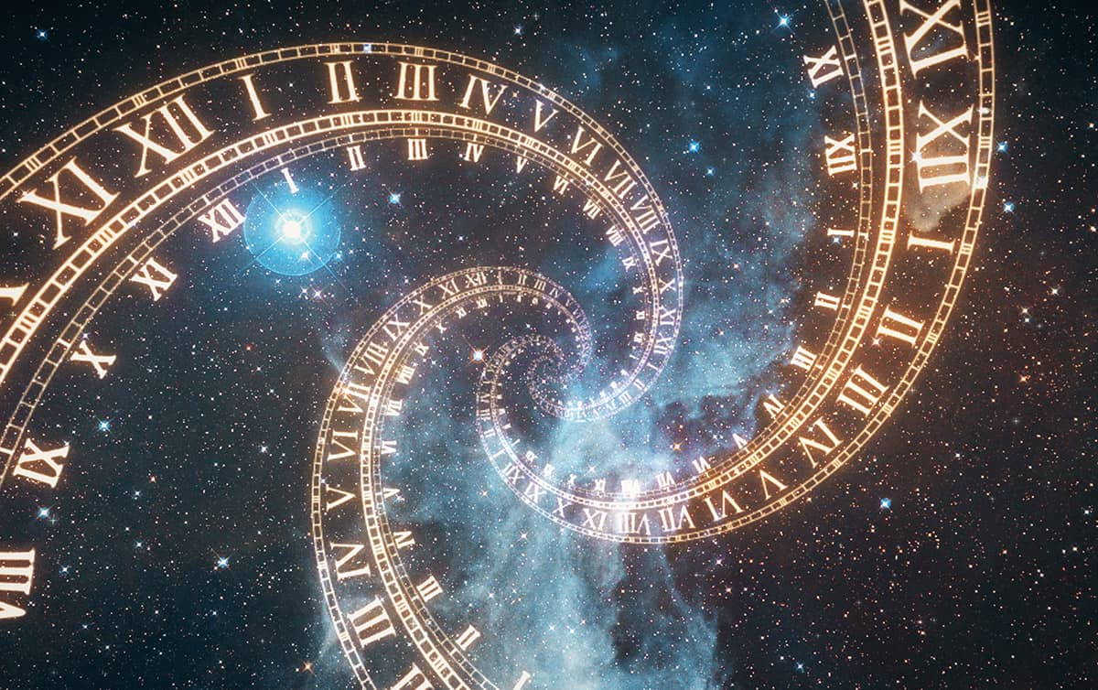

Slide 10
JEWISH CONTEXT
Daniel 3 has a particular significance for the Jews in Palestine (175-164 BCE) at the time of Antiochus IV Epiphanes (manifestation of god) aka Epimanes (the Madman), who set up a pagan idol in the Temple of Jerusalem and ordered the Jews, under pain of death, to take part in pagan worship (1 Mc 1:43-62; 2 Mc 6:1-11)

Slide 11
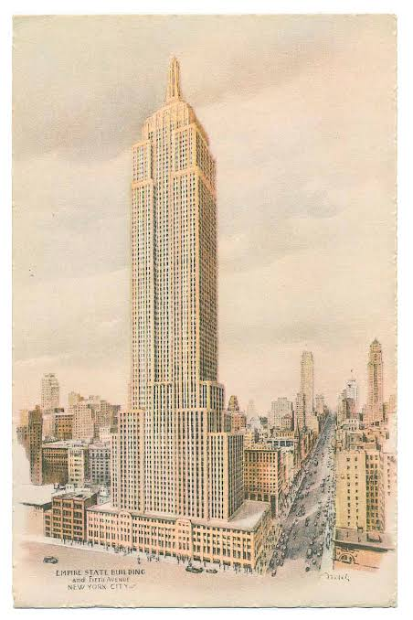
THE EMPIRE STATE BUILDING
1931
Art Deco
Mooring Station for Airships
More than 100 floors
Tallest building
Height competition
Built for corporate businesses

Slide 12
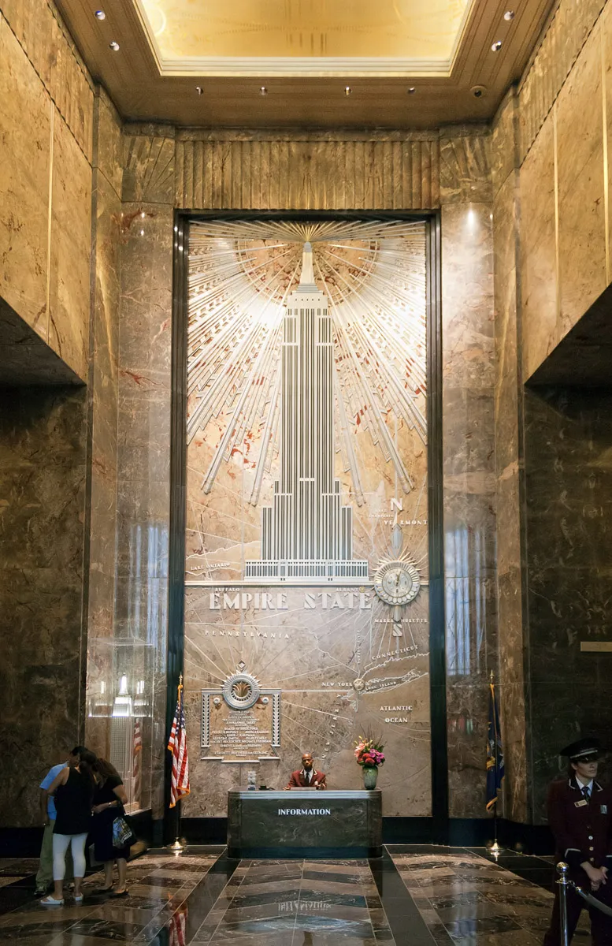
THE EMPIRE
STATE BUILDING
What do you see?
How do you ‘read’ this building?

Slide 13
OUR CONTEXT
What idols do you recognise in our culture?

Slide 14
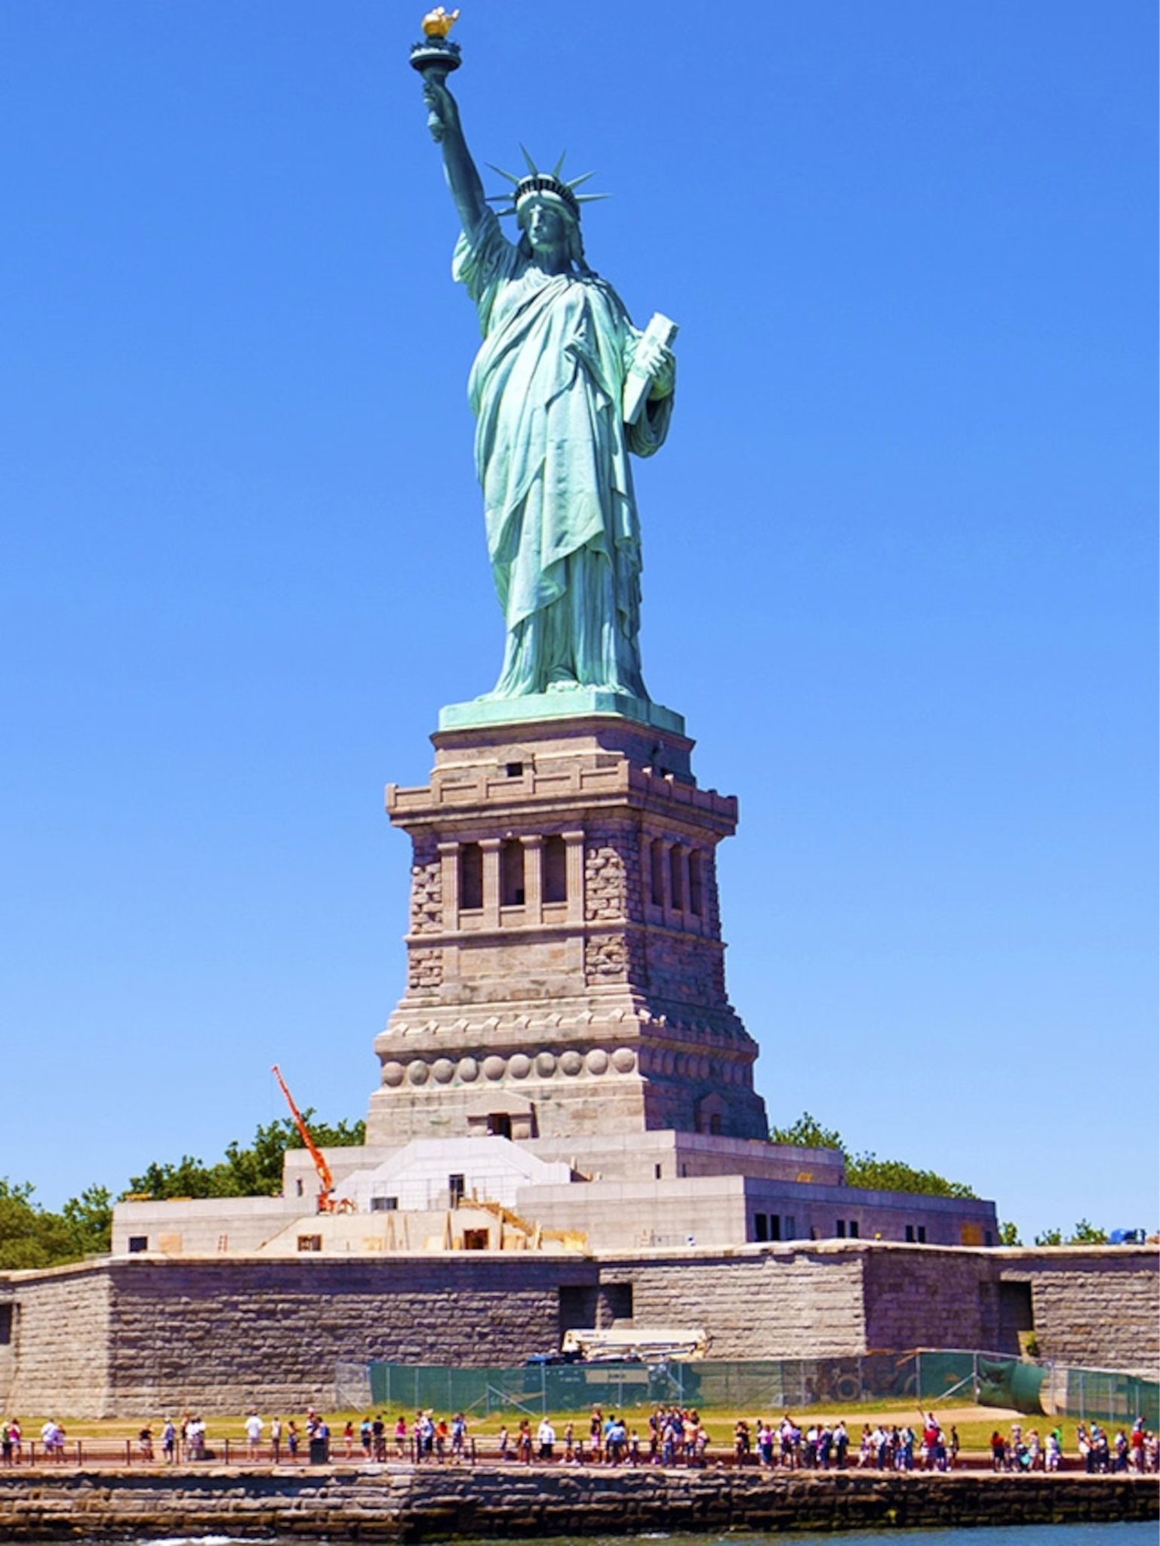
THE STATUE OF LIBERTY
The Official Name: The original French title, La Liberté éclairant le monde, means Liberty bringing light to people.
The Torch: Held high in her right hand, the light of the torch represents a beacon guiding people toward freedom and enlightenment.
The Tablet: Clutched in her left hand, the tablet displays the date July 4, 1776 in Roman numerals, marking the adoption of the United States Declaration of Independence.
The Broken Chains: Situated at her feet, broken shackles and chains symbolize the abolition of slavery and freedom from oppression or tyranny.
The Crown: The seven spikes on her crown represent the rays of the sun extending out to the seven continents and seven seas, symbolizing universal light and liberty.
Gift from France to recognise alliance and independence.

Slide 15
CHURCH & STATE: 1936
Herr Baldur von Schirach declared in 1936, “One cannot be a good German and at the same time deny God, but an arousal of faith in the eternal German is at the same time an arousal of faith in the eternal God. If we act as true Germans we act according to the laws of God. Whoever serves Adolf Hitler, the Führer, serves Germany, and whoever serves Germany serves God” (The Times [London], 29 July 1936)

Slide 16
VERSES 19-30

Slide 17
CHAPTER THREE
The Furnace
Verses 19-30
Questions & Reflections?

Slide 18
WAIT A MINUTE …?
Who’s in the furnace?

Slide 19
COMPARE
& CONTRAST
God and idols

Slide 20
FINAL THOUGHTS
28 Then Nebuchadnezzar said, “Praise to the God of Shadrach, Meshach, and Abednego! He sent his angel to rescue his servants who trusted in him. They defied the king’s command and were willing to die rather than serve or worship any god except their own God. 29 Therefore, I make this decree: If any people, whatever their race or nation or language, speak a word against the God of Shadrach, Meshach, and Abednego, they will be torn limb from limb, and their houses will be turned into heaps of rubble. There is no other god who can rescue like this!”
What’s going on here?

