Slide 1
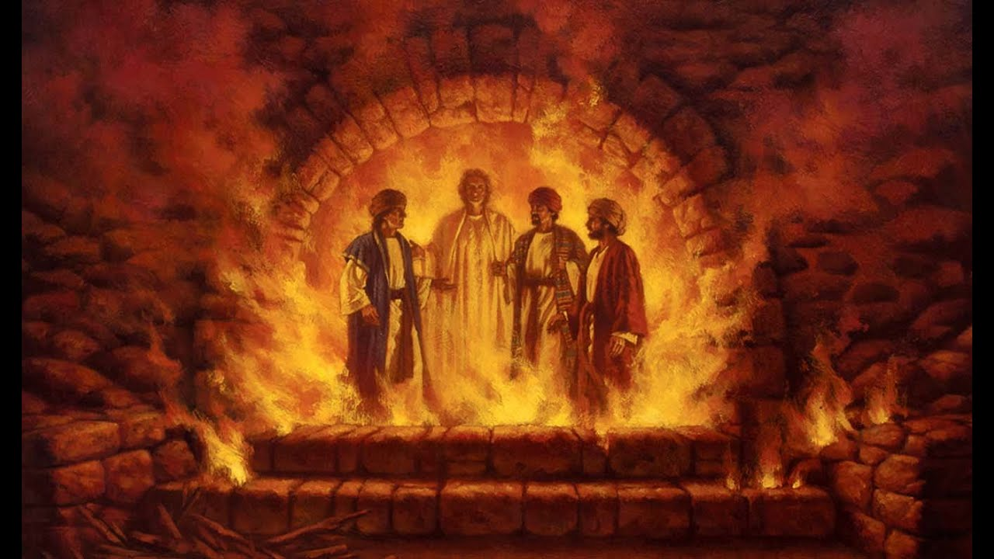
DANIEL
Righteous Hero of Faith
PRAISE, PRIDE
& PROPHECY

Slide 2
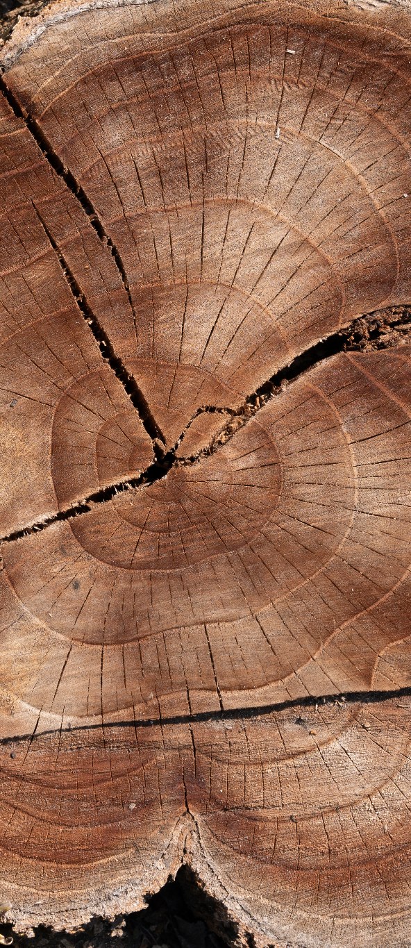
PRAYER
“I want you all to know about the miraculous signs and wonders the Most High God has performed for me.
How great are his signs,
how powerful his wonders!
His kingdom will last forever,
his rule through all generations.” (Daniel 4.2-3)
…..
praise and glorify and honor the King of heaven.
All his acts are just and true,
and he is able to humble the proud. (Daniel 4.37)
Amen.

Slide 3
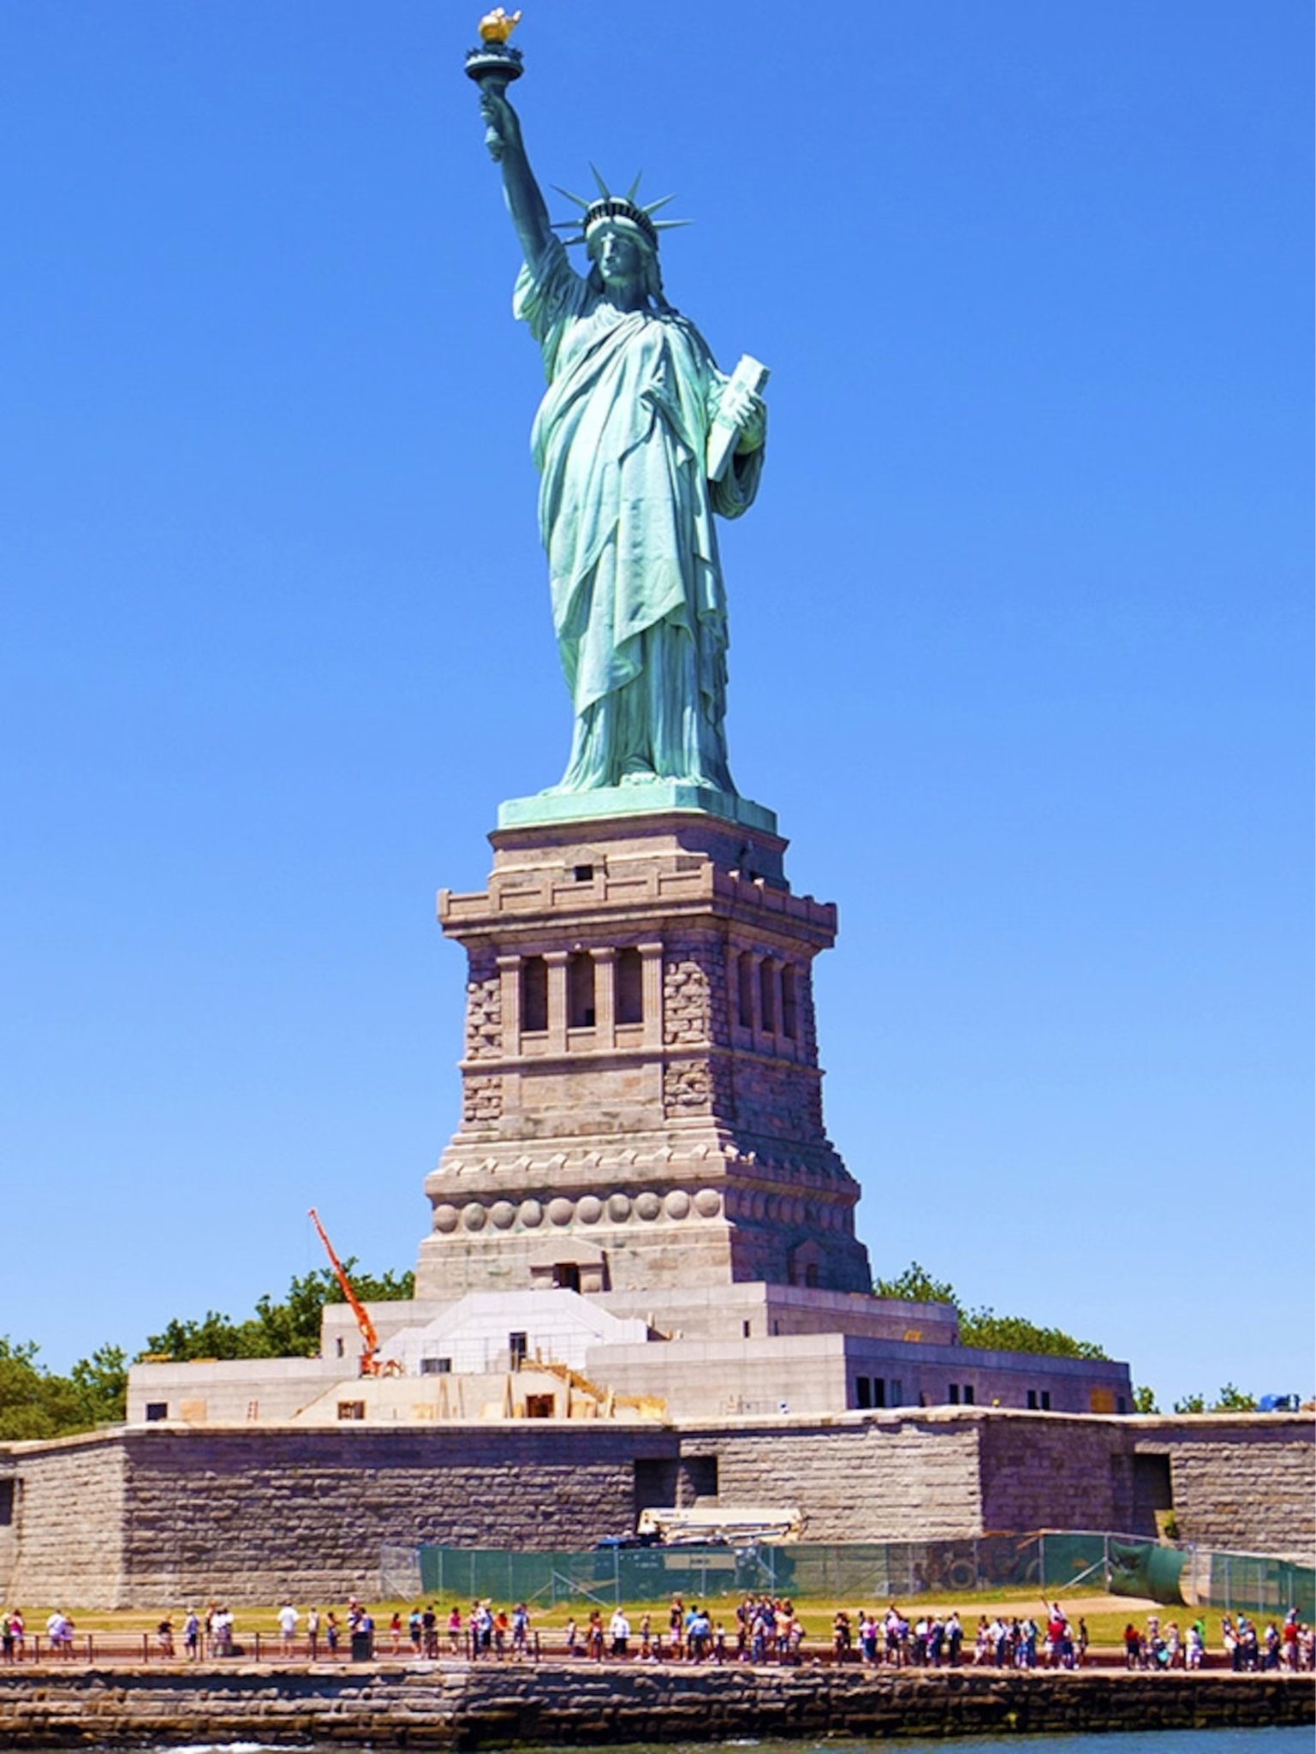
THE STATUE OF LIBERTY
The Official Name: The original French title, La Liberté éclairant le monde, means Liberty bringing light to people.
The Torch: Held high in her right hand, the light of the torch represents a beacon guiding people toward freedom and enlightenment.
The Tablet: Clutched in her left hand, the tablet displays the date July 4, 1776 in Roman numerals, marking the adoption of the United States Declaration of Independence.
The Broken Chains: Situated at her feet, broken shackles and chains symbolize the abolition of slavery and freedom from oppression or tyranny.
The Crown: The seven spikes on her crown represent the rays of the sun extending out to the seven continents and seven seas, symbolizing universal light and liberty.
Gift from France to recognise alliance and independence.

Slide 4
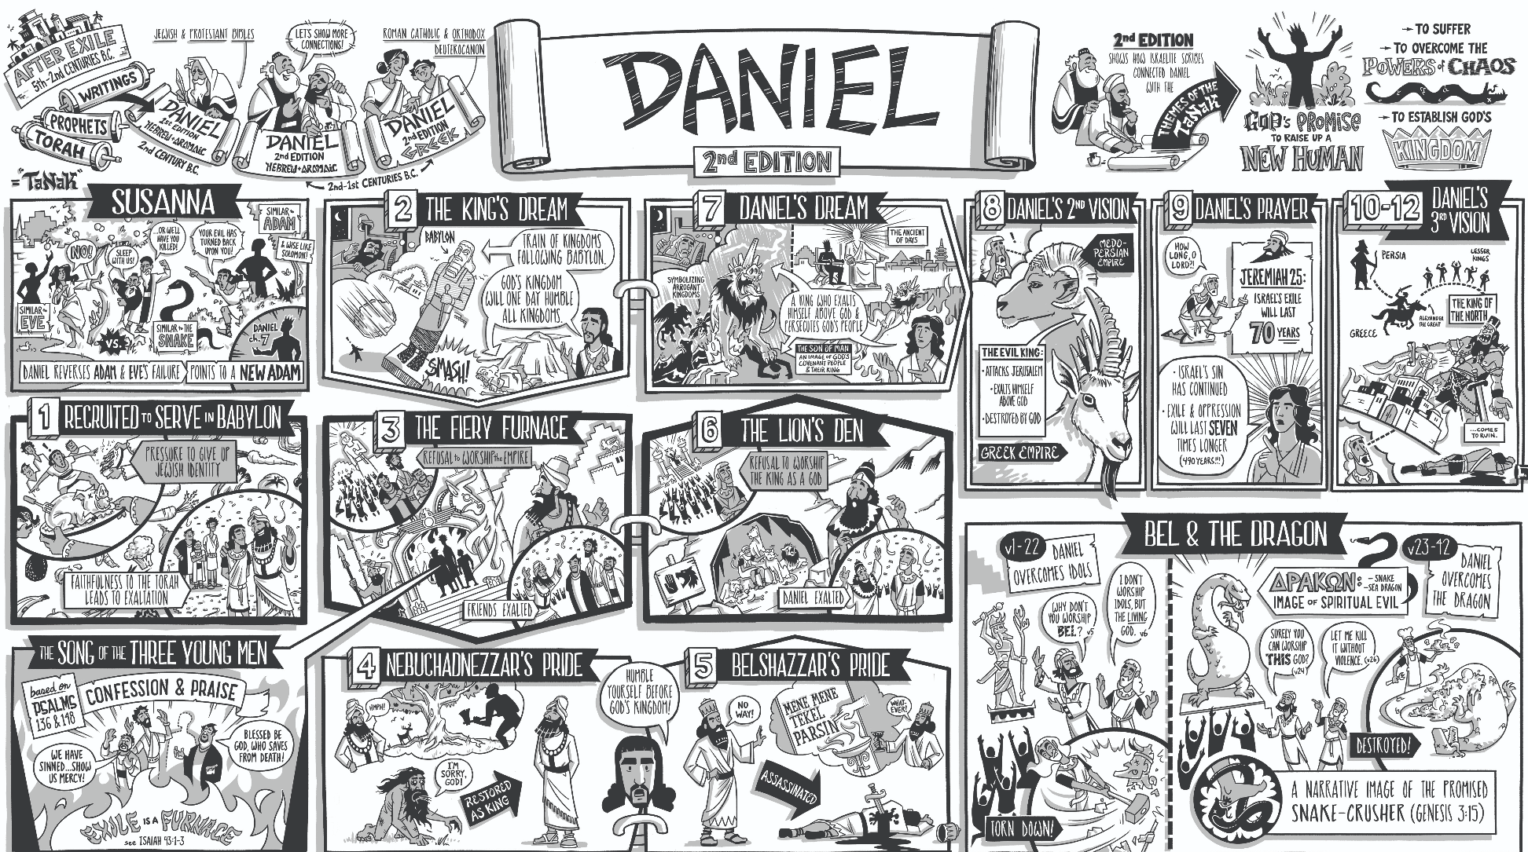

Slide 5
CHAPTER FOUR
Praise, pride and prophecy
“I want you all to know about the miraculous signs and wonders the Most High God has performed for me.” (v 1)
Theme
“praise and glorify and honor the King of heaven. All his acts are just and true, and he is able to humble the proud.” (v 18)

Slide 6
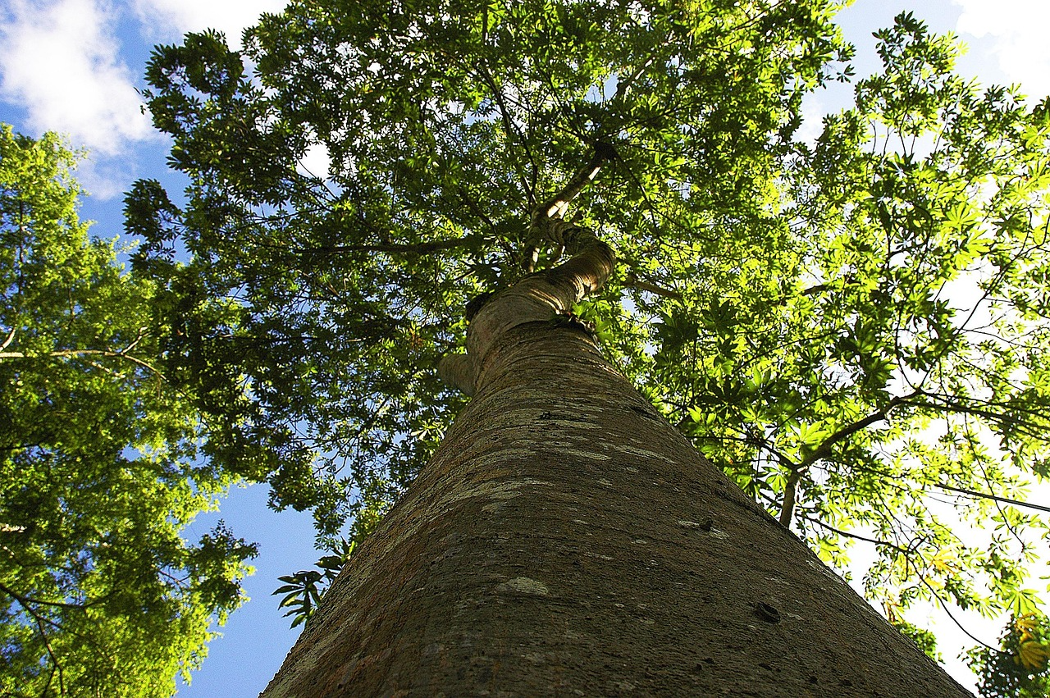
VERSES 1-12

Slide 7
VERSES 1-12
Questions & Comments?
Nebuchadnezzar is quoting from Psalms. What could that mean? (v3)
How is this the same/different from the King’s last dream & interpretation?
How influential is the tree?
And the tree is … ?

Slide 8
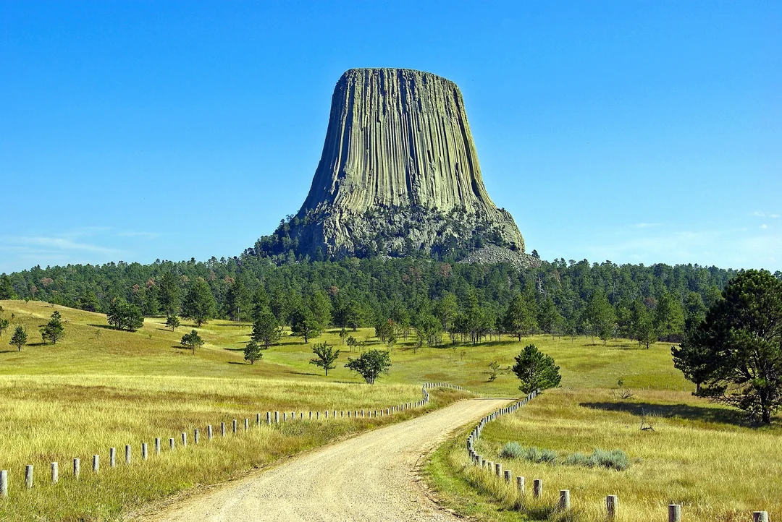
VERSES 13-18

Slide 9
VERSES 13-18
Questions & Comments?
What/who is the “messenger”? How is it translated in your version?
A bound stump?
Seven periods of time?
“The mind of a wild animal”?
And the point is …?

Slide 10
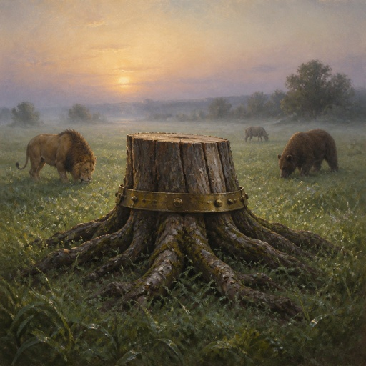
BOUND
Restraints – Straitjacket?
Good?
Bad?
Have you ever felt restrained by God?

Slide 11
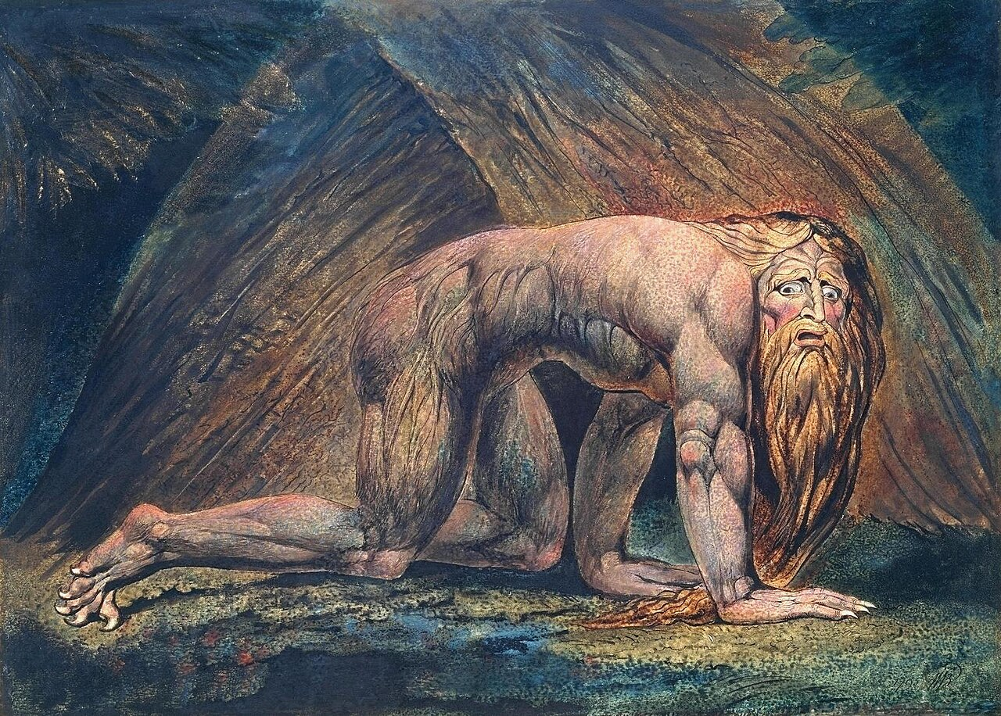
VERSES 19-27

Slide 12
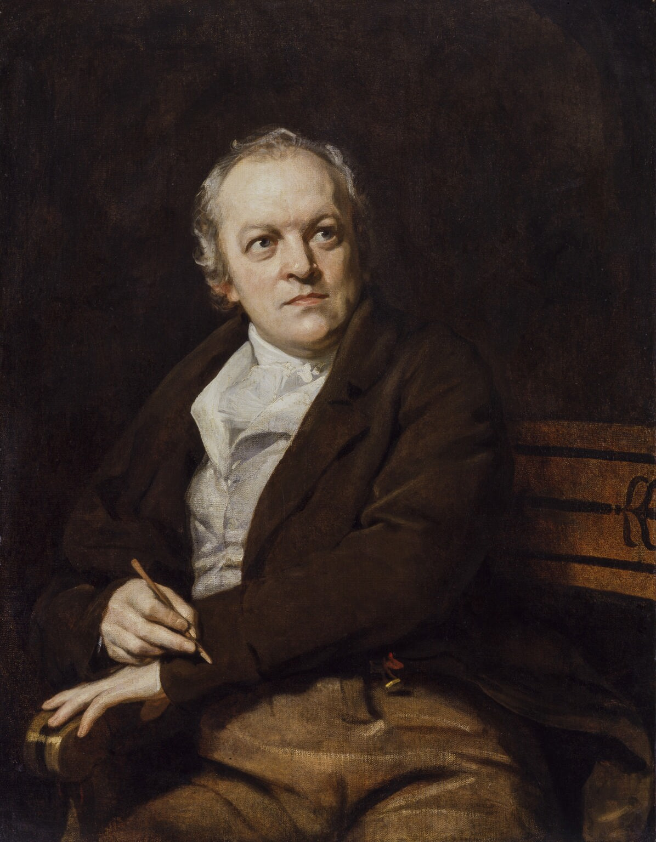
WILLIAM BLAKE
William Blake (1757–1827) was an English poet, painter, and printmaker who is now celebrated as one of the most original and visionary minds of the Romantic Age. Although he lived in poverty and relative obscurity during his lifetime—often dismissed by his peers as a madman—his revolutionary combination of visual art and verse has made him a monumental figure in both Western literature and art history.

Slide 13
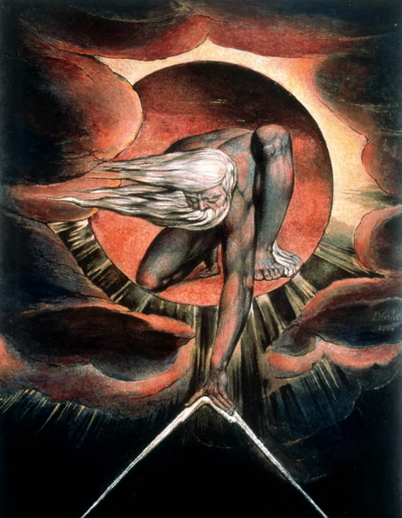
WILLIAM BLAKE
Relief Etching
Blake invented a groundbreaking printing technique called illuminated etching. He used an acid-resistant liquid to draw both his poems and illustrations onto copper plates in reverse. After etching them with acid, he and Catherine (his wife+ of 45 years) printed the pages and hand-coloured them using watercolours.

Slide 14
VERSES 19-27
Questions & Comments?
“Don’t be alarmed …” (?!)
You will be driven from human society, and you will live in the fields with the wild animals. You will eat grass like a cow …
My advice is …

Slide 15
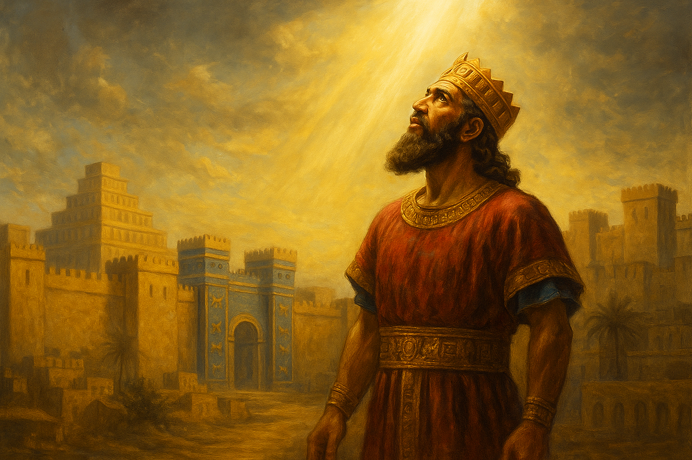
VERSES 28-37

Slide 16
VERSES 28-37
Questions & Comments?
What was the lesson to learn?
So, converted but …
Have you seen this in another’s life?
Have you experienced this in your own life?
What might God be saying to you/us?

