Slide 1
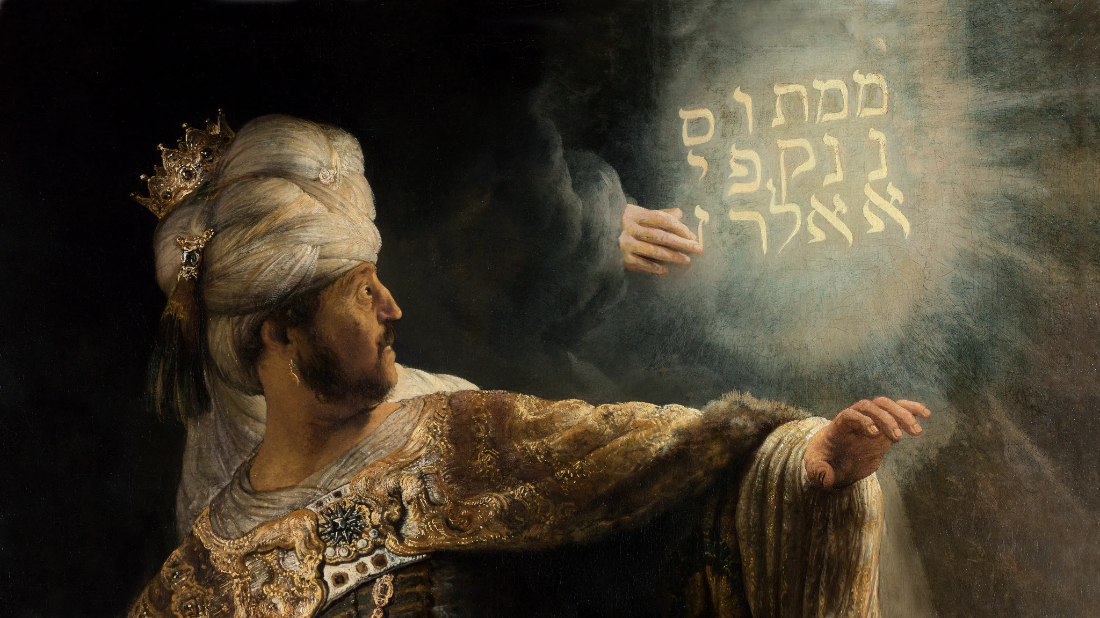
DANIEL
Righteous Hero of Faith
THE WRITING
ON THE WALL

Slide 2
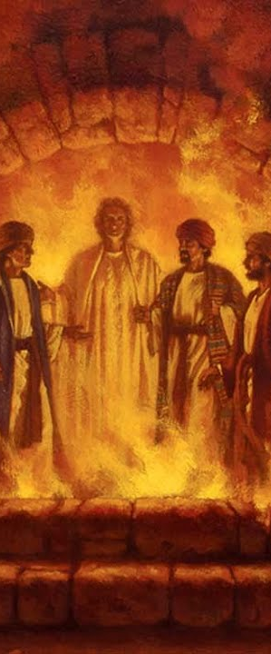
PRAYER
Let us honour the God who gives us
The breath of life and controls our destiny.
If we must be numbered and weighed,
Help us measure up.
Make us humble before you
All the days of our lives.
Amen.

Slide 3
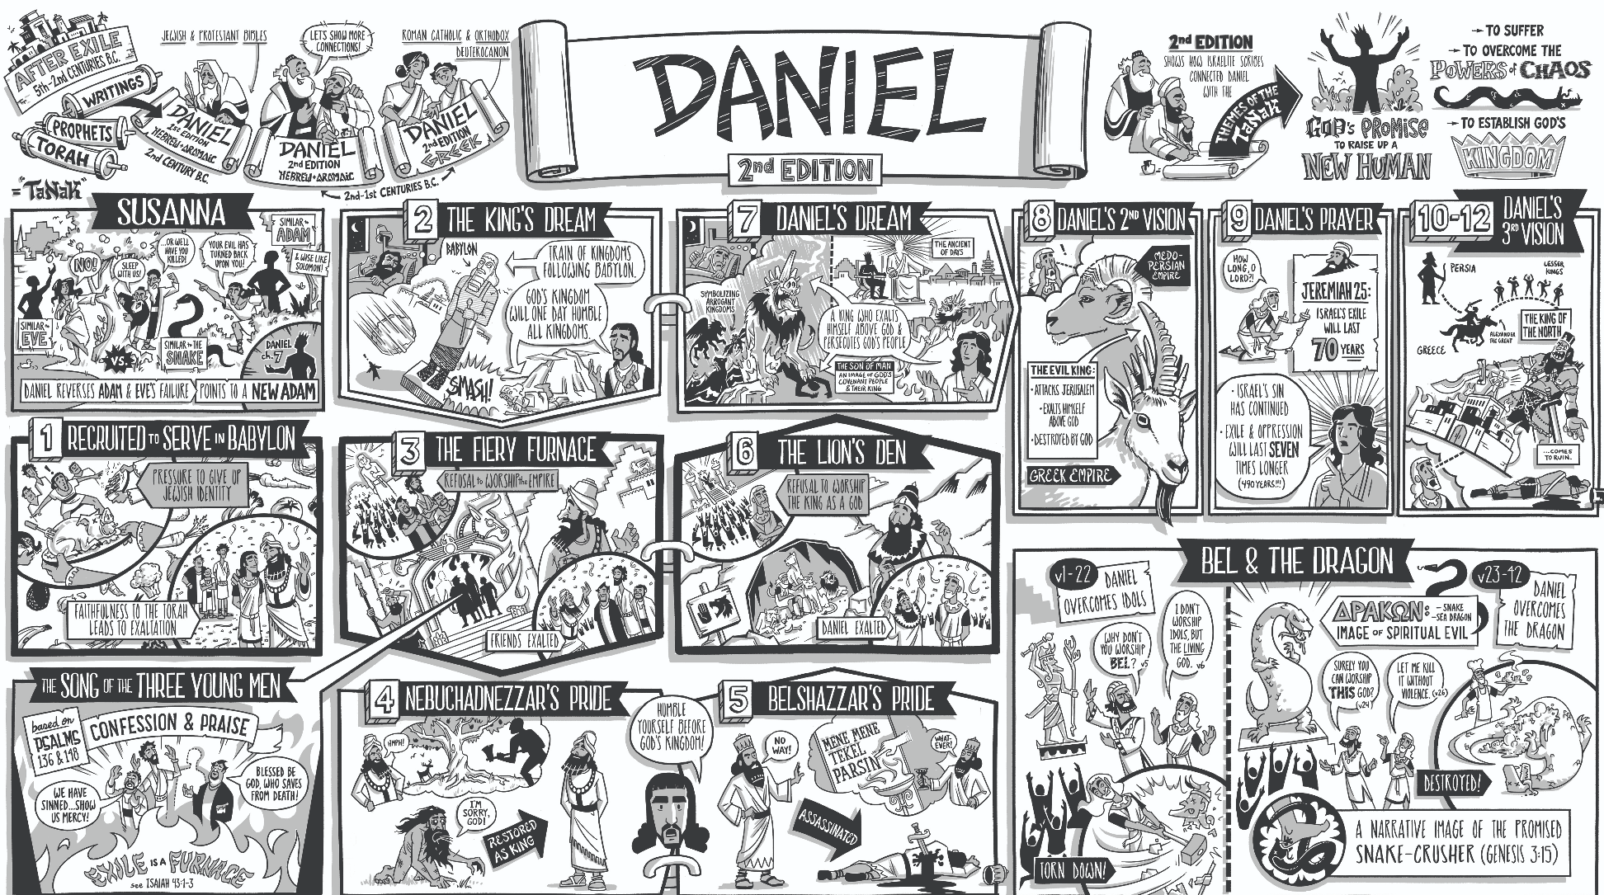

Slide 4
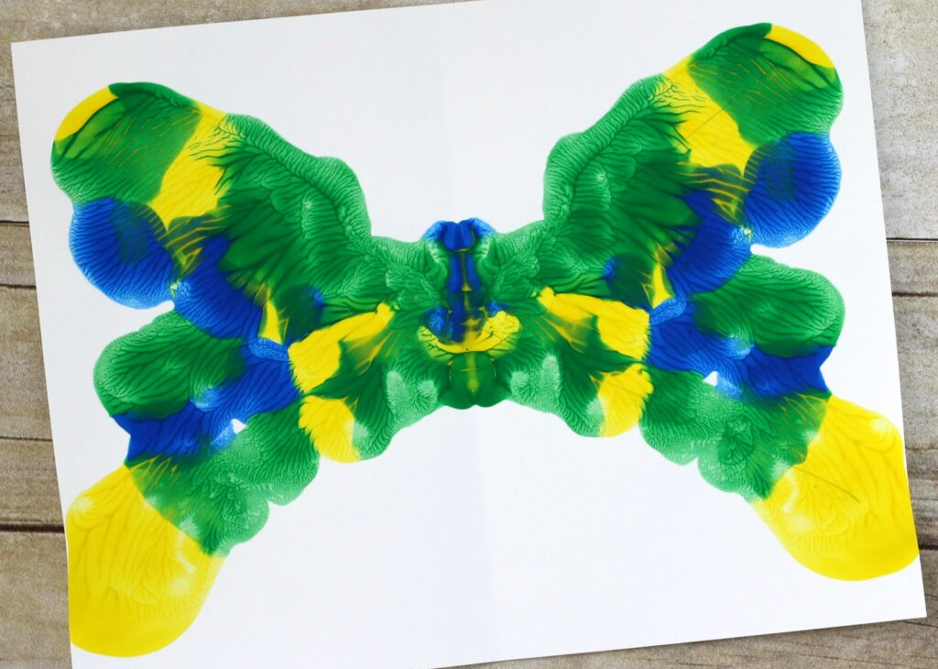
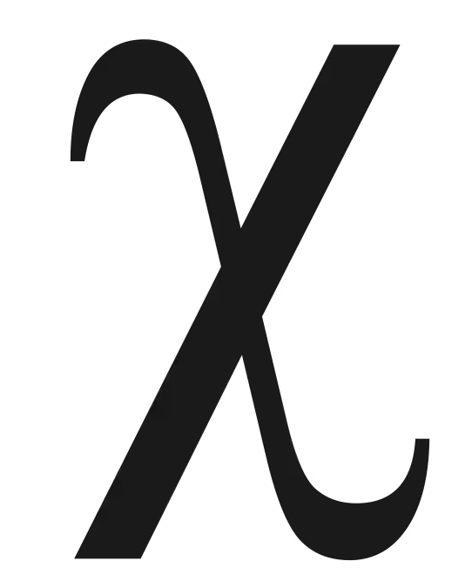
Greek letter chi.
Chiasmus

Slide 5
X
X MARKS THE SPOT
A: Daniel 2 – Prophecy of 4 world empires symbolized by statue.
B: Daniel 3 – Faithful believers persecuted & delivered (fire)
C: Daniel 4 – God humbles (& restores) a proud king
C': Daniel 5 – God judges (& deposes) a proud king
B': Daniel 6 – Faithful believer persecuted & delivered (lions)
A': Daniel 7 – Prophecy of 4 world empires symbolized by beasts.

Slide 6
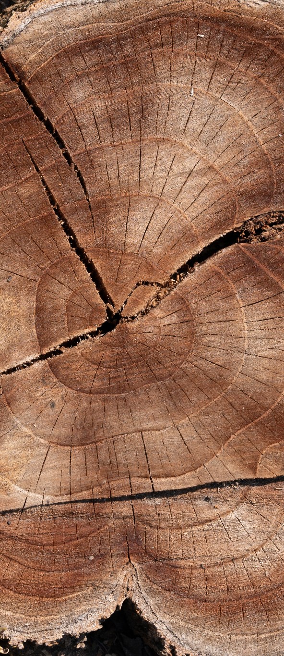
CHAPTER FIVE
The writing on the wall
“Many years later King Belshazzar gave a great feast for 1,000 of his nobles, and he drank wine with them … [from] the gold and silver cups that his predecessor, Nebuchadnezzar, had taken from the Temple in Jerusalem. … While they drank from them they praised their idols made of gold, silver, bronze, iron, wood, and stone.” (v 1-4)
Theme
“praise and glorify and honor the King of heaven. All his acts are just and true, and he is able to humble the proud.” (v 18)

Slide 7
BELSHAZZAR
Bel: Refers to Marduk, the chief patron deity and "lord" of the Babylonian Empire.
Shar: Means "king".
Uṣur: A prayer or command meaning "protect" or "guard"

Slide 8
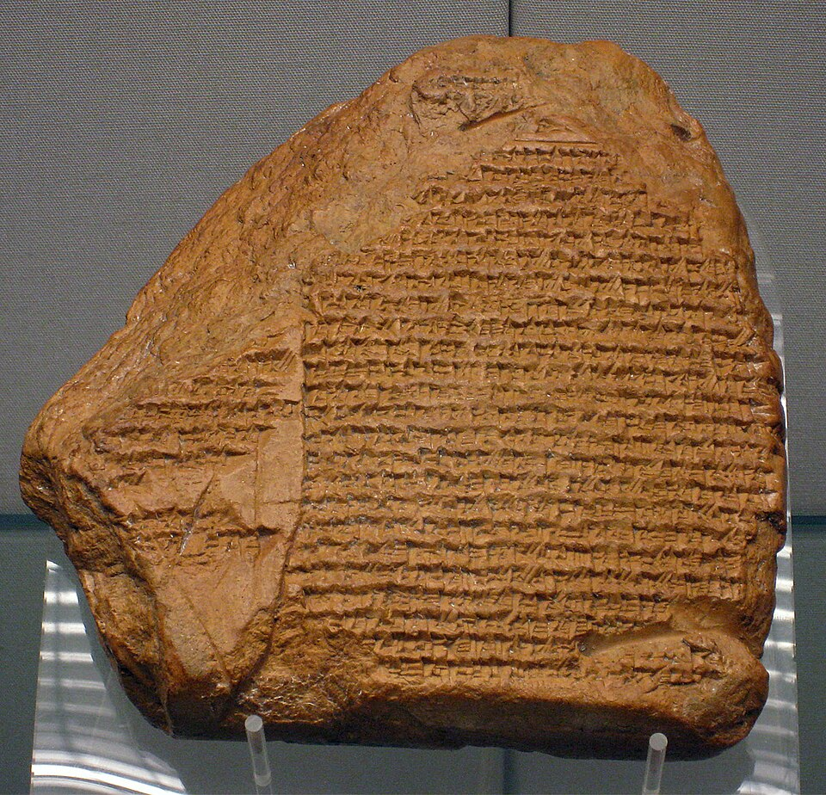
BELSHAZZAR IN HISTORY
Son of Nabonidus (perhaps grandson of Nebuchadnezzar)
Probable orchestrator of coup
d'etat that brought his elderly
father to power and made him heir
Last regent of Neo-Babylonian Empire
The Nabonidus Chronicle, an ancient Babylonian text which chronicles the reign of Belshazzar's father and also documents the period during which Belshazzar was regent in Babylon

Slide 9
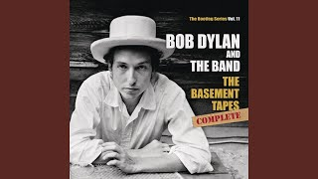
Belshazzar - Bob Dylan (Johnny Cash)
Well the Bible tells about a man
Who ruled Babylon and all its land
Around the city he built a wall
And declared that Babylon would never fall
He had concubines and wives
He called his Babylon "Paradise"
Upon his throne he drank and ate
But for Belshazzar it was getting late…

Slide 10
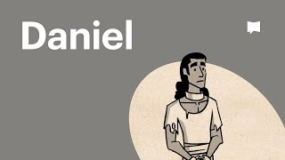

Slide 11
VERSES 1-12

Slide 12
VERSES 1-12
Questions & Comments?
What’s the offense?
“The knots of his loins were loosened” (v6)

Slide 13
GIRD YOUR LOINS!
Which means …?
To be prepared
  Mentally
  Physically

Slide 14
NOW READ VERSE 9
“The knots of his loins were loosened”
To be ‘undone’
  ill-prepared
  weak-kneed
  sphincter issues …

Slide 15
FAMILIAR FORMAT
Interpretation required
Diviners called
Reward promised
Failure
Enter Daniel

Slide 16
FAMILIAR FORMAT
Interpretation required
Diviners called
Reward promised
Failure
Enter Daniel

Slide 17
WISDOM
Institutional memory is crucial. Those who hold it grant access to the whats and whys of how we do things today.
Who holds those memories and how can they help?

Slide 18
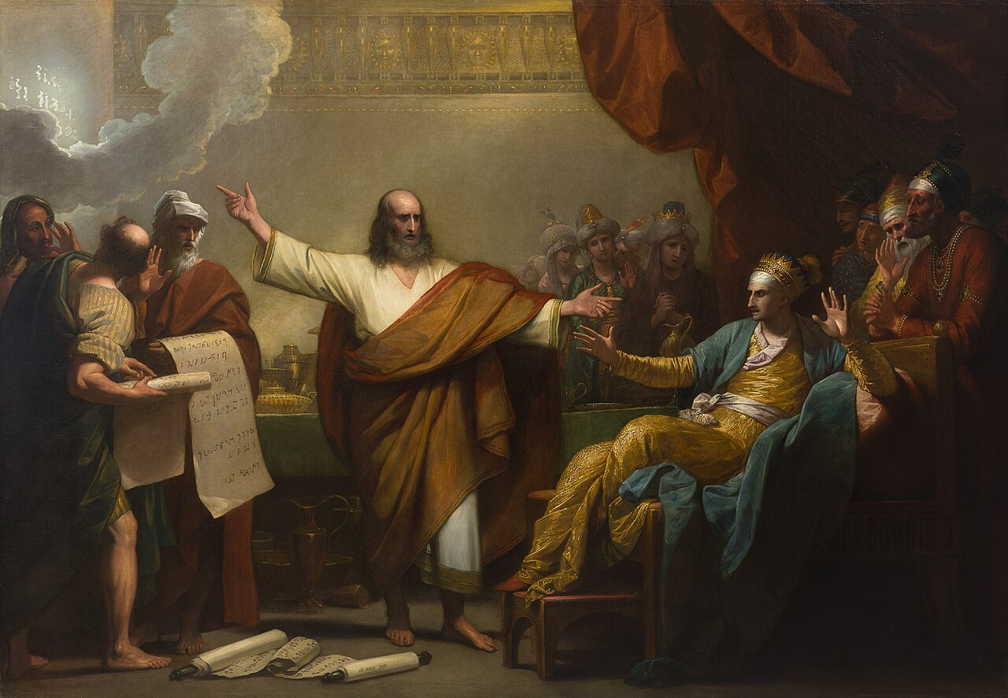
VERSES 13-30

Slide 19
VERSES 13-30
Questions & Comments?
Rewards offered & refused?
Nebuchadnezzar’s source of power?
Model: pride → humility → restoration?
Consequences?
Succession?

Slide 20
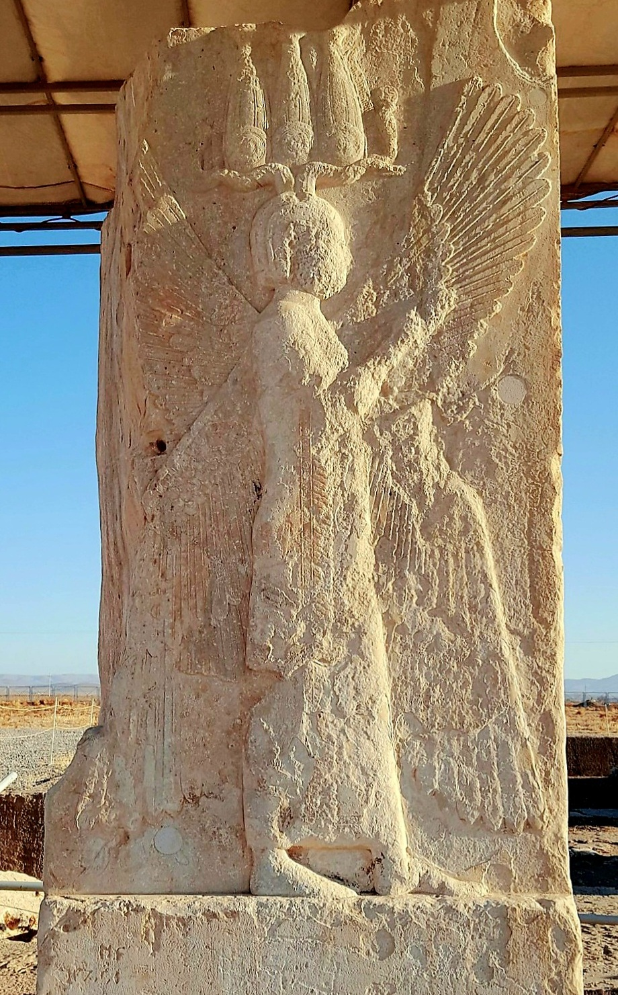
DARIUS THE MEDE?
Not recorded in history
In 539, Bablyon was absorbed by the persian Empire under the rule of Cyrus the Great.
Cyrus is recorded as the ruler who released the exiled Jews.

Slide 21
FOUND WANTING…
‘MENE, God has numbered the days of your kingdom and brought it to an end; TEKEL, you have been weighed on the scales and found wanting; PERES, your kingdom is divided and given to the Medes and Persians.’

Slide 22
INVITATION
If God were to write a message on the wall for you, what might it say?
Prayer

